Slide 1
2015 AKR eQuotation SOP
Iris Tsai
30th Oct., 2015

Slide 2
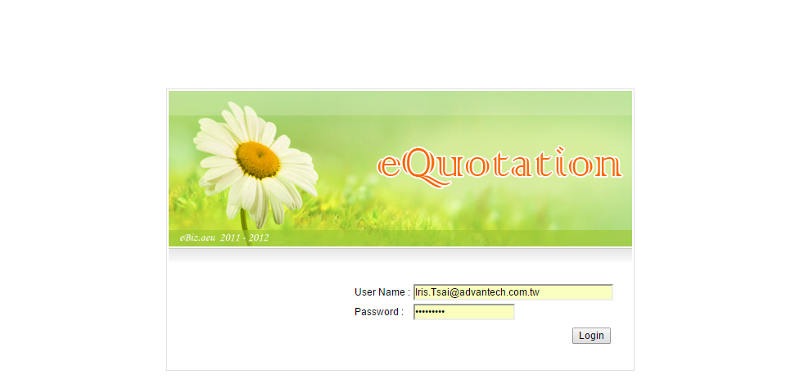
Step 1. Log in eQuotation
http://eq.advantech.com/login.aspx

Slide 3
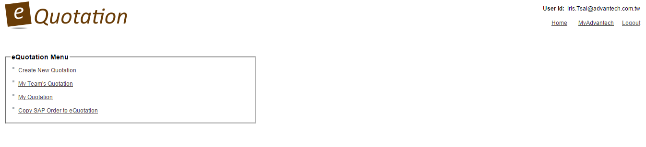
Step 2-1. Create New Quotation
http://eq.advantech.com/login.aspx
Create a new quotation.
View all PRO.AKR’s quotation.
View my quotation.
Create quotation from previous SAP/eStore order/quotation.
AKR eQuotation SOP (will be added)

Slide 4
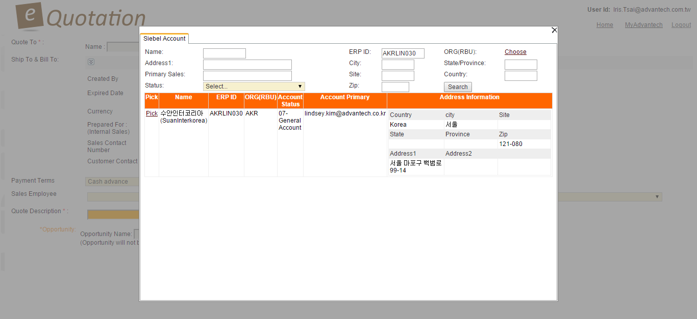
Step 2-2. Pick Quotation Account
http://eq.advantech.com/login.aspx
1. Fill in at least 1 Siebel account info to query.
2. Pick 1 Siebel account.

Slide 5
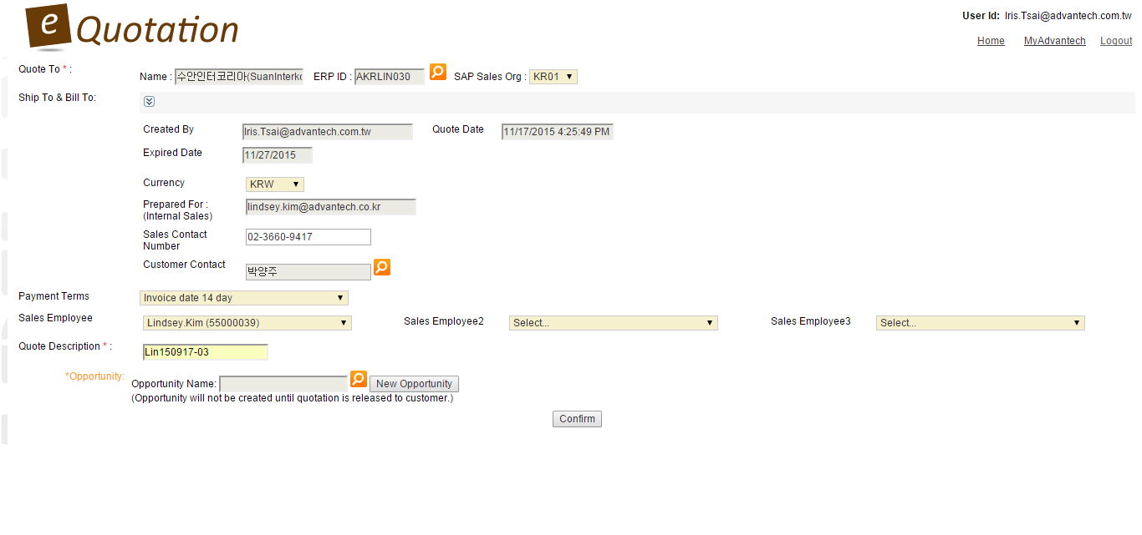
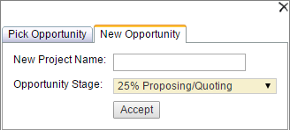
Step 2-3. Fill in Quotation Basic Info
http://eq.advantech.com/login.aspx
1. Fill in your contact number
2. Pick account Siebel contact
3. If order quota will be shared, select multiple sales.
4. Fill in quotation reference no..
5. Type or pick this quotation’s Siebel oppty by project
name or create an oppty directly via eQ.
(*Oppty stage can’t be 0% or 100%)

Slide 6
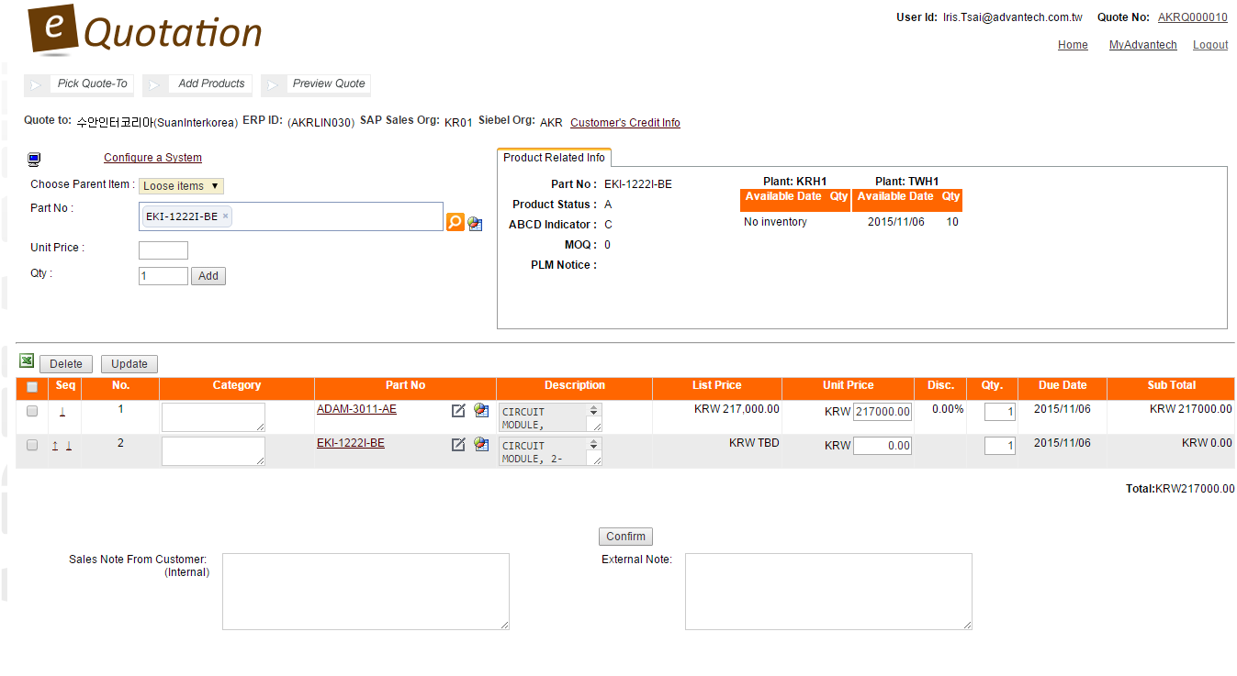
Step 3-1. Add Standard Product PN into Quotation
http://eq.advantech.com/login.aspx
1. Search standard product PN.
2. Check PN status/inventory here.
IMPORTANT:
Loose items show prices separately by PN.
3. Modify price & qty.
Draft quotation is created, once clicked confirm.

Slide 7
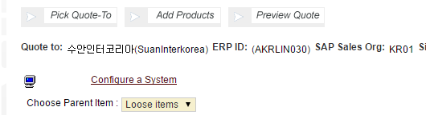
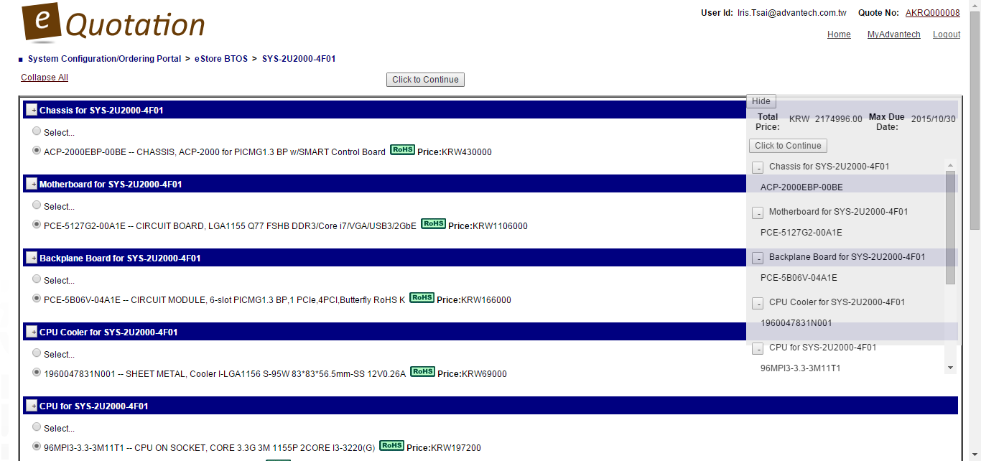
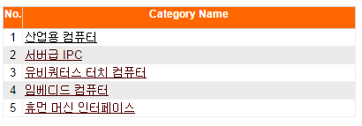
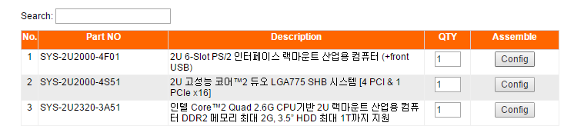
Step 3-2. Pick CTOS Items from eStore CBOM
http://eq.advantech.com/login.aspx
1. Select from eStore products.
4. Pick CTOS items to add to quotation.
2. Select eStore CTOS category.
3. Pick the CTOS PN.

Slide 8
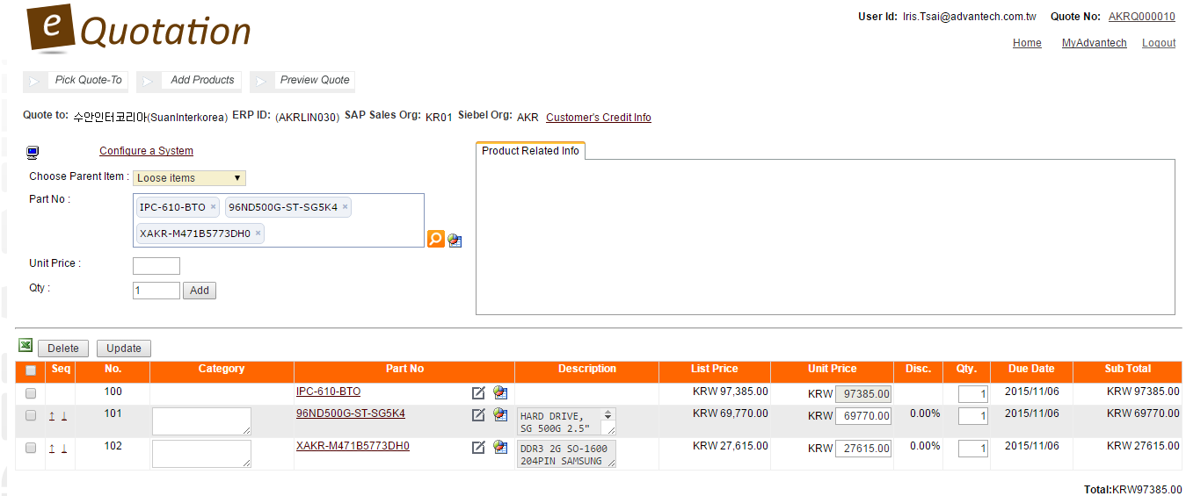
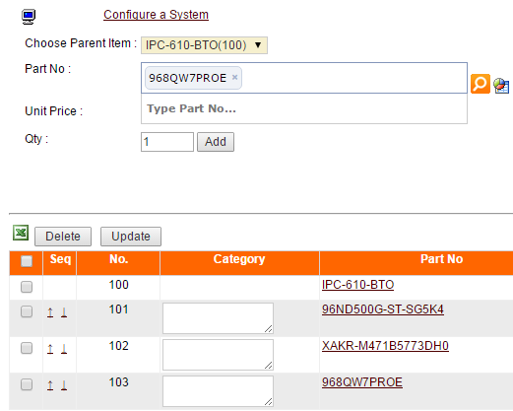
Step 3-3. Add CTOS Items Manually
http://eq.advantech.com/login.aspx
Put parent item first.
1. Add CTOS items
manually one by one.
2. To add another item into CTOS group, choose parent item first.
IMPORTANT:
To show only total price of CTOS, please group items no. together.
eg.
100,101,102,103 → CTOS1
200,201,202,203 → CTOS2
Notes:
Parent item example: IPC-610-BTO

Slide 9
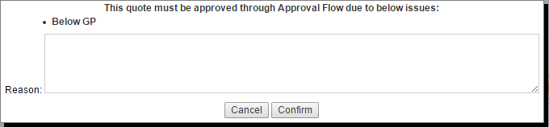
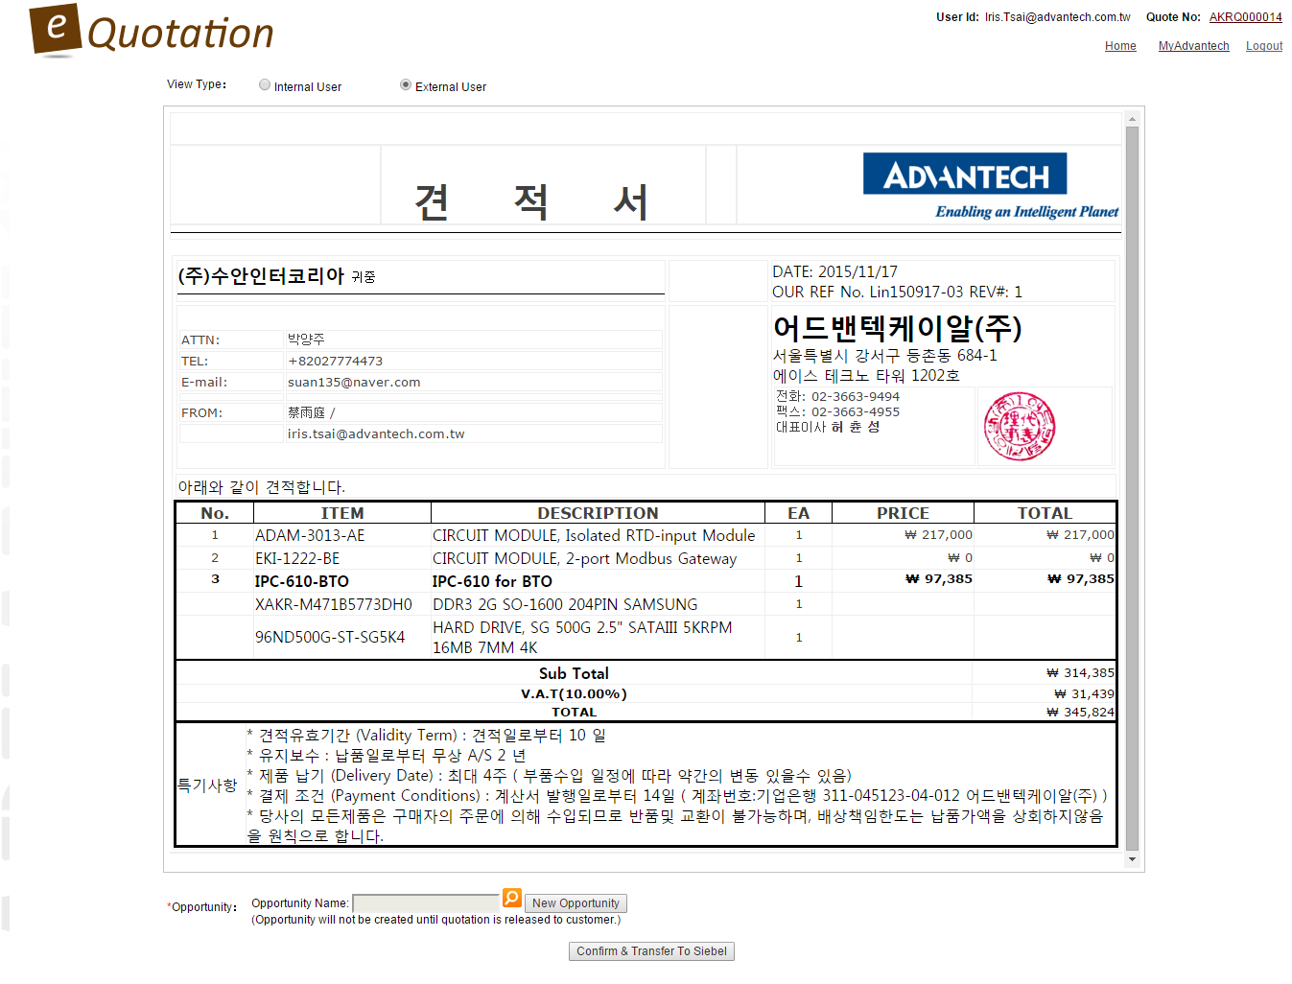
Step 4. Preview & Finish Quotation Creation
http://eq.advantech.com/login.aspx
If the quotation profit is below 30%, eQ will start GP control approval flow. (appendix2)
Clicked confirm to finish creating this quotation.

Slide 10
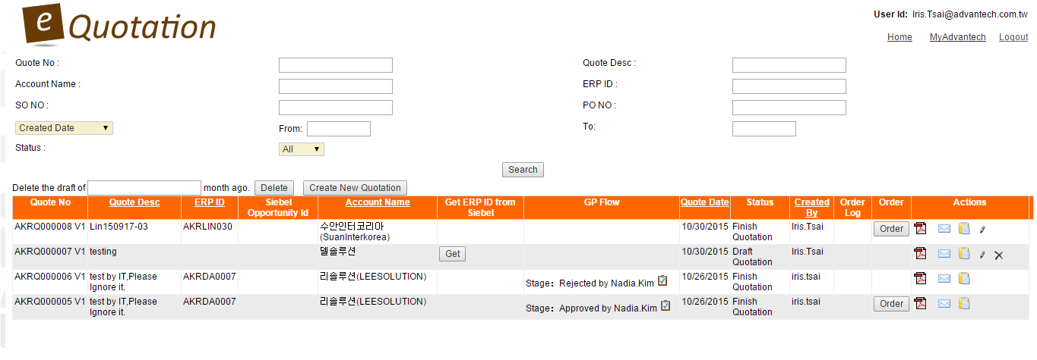
Step 5. Revise & Create New Version
http://eq.advantech.com/login.aspx
Search specific quotations by filling at least 1 field.
Attach product images here.
6.
1.
2.
3.
4.
5.
1. Download quotation pdf.
2. Send quotation w/ email greeting & product images. (appendix4)
3. Copy old quotation to create a new one.
4. Edit/create new version of quotation. (appendix3)
5. Delete quotation.
6. Convert quotation to SAP order directly.

Slide 11
Appendix

Slide 12
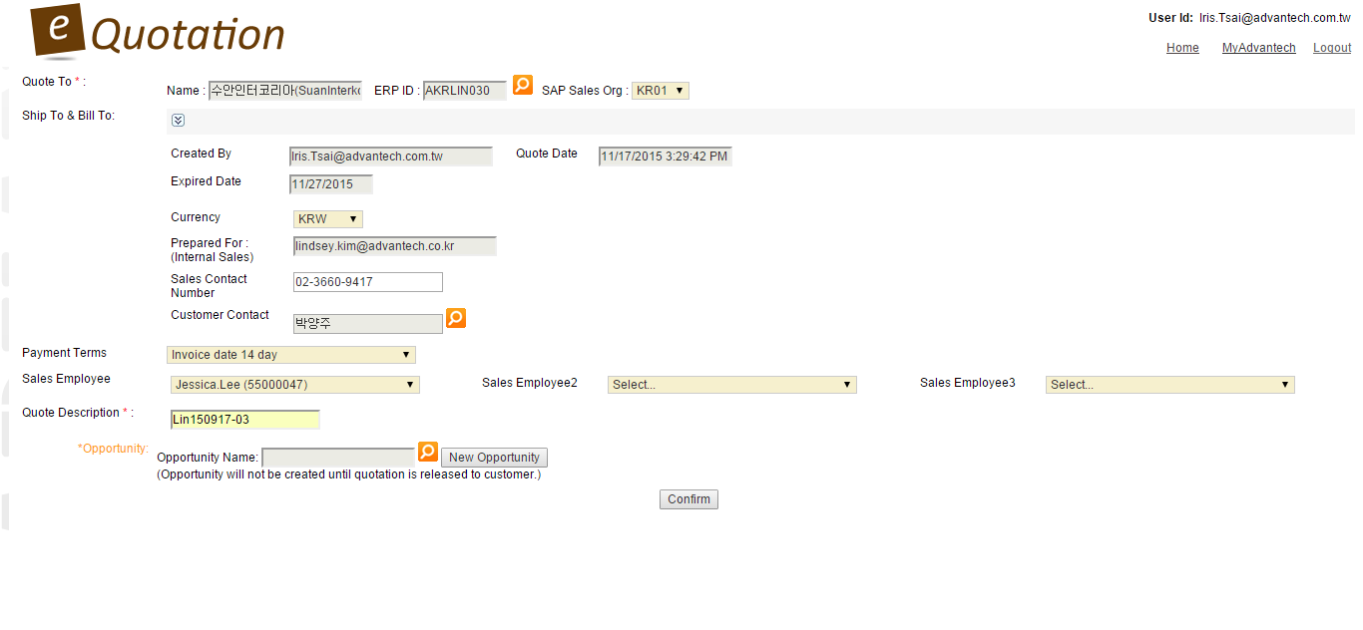
Appendix1. What Will Display on Final Quotation?
http://eq.advantech.com/login.aspx
Account Name (SAP)
Validity Term
Quote Date
From
ATTN
Payment Conditions
OUR REF No.

Slide 13
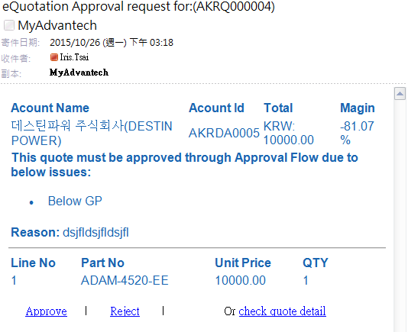
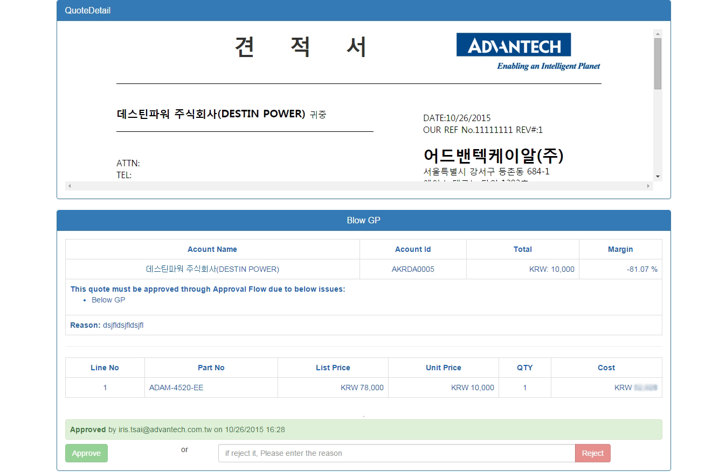
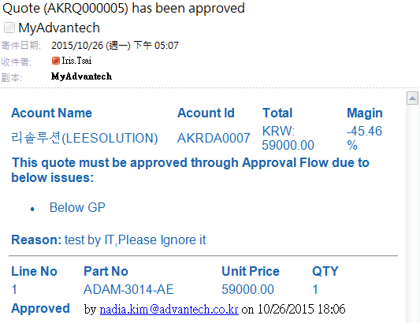
Appendix2. Quotation GP Control Approval
http://eq.advantech.com/login.aspx
1.
eQuotation will send approval notification to Nadia.Kim for approval.
Approve or reject quotation.
2.
Sales will receive notification once Nadia approved/rejected.
Approve or reject quotation, and fill in reject reason.

Slide 14
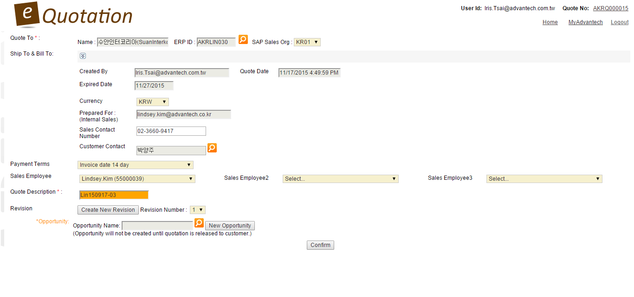
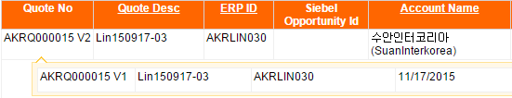
Appendix3. Revise Quotation & Create Multiple Versions
http://eq.advantech.com/login.aspx
1. Click Edit.
2. 2nd version will be created.
1. Click Create New Revision.

Slide 15
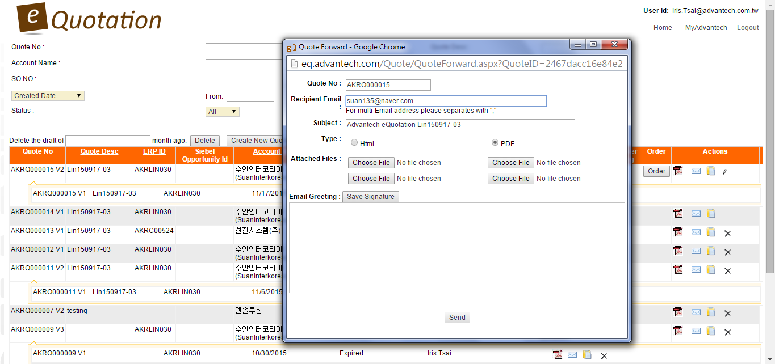
Appendix4. Attach Product Image, Save Greeting Template
http://eq.advantech.com/login.aspx
Attach product images.
(* each image size max.1MB, file type: png, jpg, gif, bmp)
Save your greeting template.

